Slide 1
ns-3 training
From ns-3 annual meeting 2019

Slide 2
ns-3 from the ground up
ns-3 is written in C++
most code conforms to C++98 standard (starting to use C++11), and makes use of the STL (standard template library)
ns-3 makes use of a collection of C++ design patterns and enhancements with applicability to network simulation
ns-3 experiments can be written in Python (more on that later)
ns-3 programs make use of standard C++, ns-3 libraries written in C++, and (optionally) third-party C++ libraries
ns-3’s build system requires a working Python (soon to require Python 3)
Various other tools can be used to handle output data
We’ll focus on Python matplotlib and Gnuplot

Slide 3
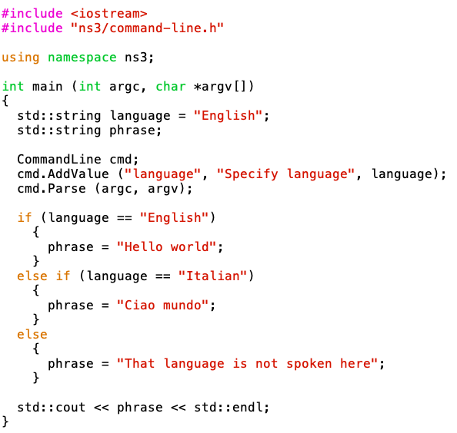
Example ns-3 program
Located in scratch/ns3-hello-world.cc
This is basic C++, except:
we are using methods
defined in an ‘ns3’
namespace
2) The object ‘cmd’ is an instance of the CommandLine C++ class.
CommandLine exists in C++ namespace ‘ns3’.
CommandLine objects process command-line arguments.

Slide 4
ns-3 from the top down
Rather than (just) CommandLine objects, ns-3 combines objects like ‘Packets’, ‘Nodes’, ‘Applications’, etc.
Application
Application
Application
Application
Sockets-like
API
Protocol
stack
Protocol
stack
Packet(s)‏
Node
Node
NetDevice
NetDevice
NetDevice
Channel
NetDevice
Channel

Slide 5
Discrete-event simulation basics
We are trying to represent the operation of a network within a single C++ program
We need a notion of virtual time and of events that occur at specified (virtual) times
We need a data structure (scheduler) to hold all of these events in temporal order
We need an object (simulator) to walk the list of events and execute them at the correct virtual time
We can choose to ignore things that conceptually might occur between our events of interest, focusing only on the (discrete) times with interesting events

Slide 6
Discrete-event simulation basics (cont.)
Simulation time moves in discrete jumps from event to event
C++ functions schedule events to occur at specific simulation times
A simulation scheduler orders the event execution
Simulation::Run() executes a single-threaded event list
Simulation stops at specified time or when events end
Execute a function
(may generate additional events)
Virtual time
Advance the virtual time
to the next event (function)

Slide 7
ns-3 simulation basics and terminology
A simulation ‘run’ or ‘replication’ usually consists of the following workflow
Before the notional ‘time 0’, create the scenario objects and pre-populate the scheduler with some initial events
Define stopping criteria; either a specific future virtual time, or when certain criteria are met
Start the simulation (which initializes objects, at ‘time 0’)
Before time 0,
create and configure
objects, and insert
some events into
the schedule
Execute a function
(may generate additional events)
Virtual time
Advance the virtual time
to the next event (function)
Time 0
Stop at time 60

Slide 8
Virtual time in ns-3
Time is stored as a large integer in ns-3
Minimize floating point discrepancies across platforms
Special Time classes are provided to manipulate time (such as standard operators)
Default time resolution is nanoseconds, but can be set to other resolutions
Note: Changing resolution is not well used/tested
Time objects can be set by floating-point values and can export floating-point values
double timeDouble = t.GetSeconds();
Best practice is to avoid floating point conversions where possible and use Time arithmetic operators

Slide 9
Key building blocks: Callback and function pointer
C++ methods are often invoked directly on objects
Unlike CommandLine.AddValue(),
we more generally need to
call functions at some
future (virtual) time.
Some program element
could assign a function
pointer, and a (later)
program statement could call
(execute) the method

Slide 10
Events in ns-3
Events are just functions (callbacks) that execute at a simulated time
nothing is special about functions or class methods that can be used as events
Events have IDs to allow them to be cancelled or to test their status

Slide 11
Simulator and Scheduler
The Simulator class holds a scheduler, and provides the API to schedule events, start, stop, and cleanup memory
Several scheduler data structures (calendar, heap, list, map) are possible
"Realtime" simulation implementation aligns the simulation time to wall-clock time
two policies (hard and soft limit) available when the simulation and real time diverge

Slide 12
Simulation setup
We have already explained the operation of the start of the program (configuring default values and command line arguments)
int
main (int argc, char *argv[])
{
DataRate dataRate = DataRate ("100Mbps");
...
CommandLine cmd;
cmd.AddValue("distance","the distance between the two nodes",distance);
...
cmd.Parse (argc, argv);

Slide 13
Nodes and ns-3 Objects
The next statements create the scenario, usually starting with the Node objects:
Ptr<Node> senderNode = CreateObject<Node> ();
Ptr<Node> receiverNode = CreateObject<Node> ();
NodeContainer nodes;
nodes.Add (senderNode);
nodes.Add (receiverNode);
What is CreateObject<Node> ()?
What is a NodeContainer?

Slide 14
class ns3::Object
ns-3 is, at heart, a C++ object system
ns-3 objects that inherit from base class ns3::Object get several additional features
smart-pointer memory management (Class Ptr)
dynamic run-time object aggregation
an attribute system
Instead of:
Node* senderNode = new Node;
in ns-3, we write
Ptr<Node> senderNode = CreateObject<Node> ();
Create a new Node object on the heap
Create a smart pointer to hold objects of type Node

Slide 15
ns-3 attributes
Attributes are special member variables that the Object system exposes in a way to facilitate configuration
An Attribute can be connected to an underlying variable or function
e.g. TcpSocket::m_cwnd;
or a trace source

Slide 16
Helper API
The ns-3 “helper API” provides a set of classes and methods that make common operations easier than using the low-level API
Consists of:
container objects
helper classes
The helper API is implemented using the low-level API
Each function applies a single operation on a ''set of same objects”
A typical operation is "Install()"

Slide 17
Containers
Containers are part of the ns-3 “helper API”
Containers group similar objects, for convenience
They are often implemented using C++ std containers
Container objects also are intended to provide more basic (typical) API

Slide 18
Helper API examples
NodeContainer: vector of Ptr<Node>
NetDeviceContainer: vector of Ptr<NetDevice>
InternetStackHelper
WifiHelper
MobilityHelper
OlsrHelper
... many ns-3 models provide a helper class

Slide 19
Installation onto containers
Installing models into containers, and handling containers, is a key API theme
NodeContainer c;
c.Create (numNodes);
...
mobility.Install (c);
...
internet.Install (c);
...

Slide 20
Native IP models
IPv4 stack with ARP, ICMP, UDP, and TCP
IPv6 with ND, ICMPv6, IPv6 extension headers, TCP, UDP
IPv4 routing: RIPv2, static, global, NixVector, OLSR, AODV, DSR, DSDV
IPv6 routing: RIPng, static

Slide 21
IP address configuration
An Ipv4 (or Ipv6) address helper can assign addresses to devices in a NetDevice container
Ipv4AddressHelper ipv4;
ipv4.SetBase ("10.1.1.0", "255.255.255.0");
csmaInterfaces = ipv4.Assign (csmaDevices);
...
ipv4.NewNetwork (); // bumps network to 10.1.2.0
otherCsmaInterfaces = ipv4.Assign (otherCsmaDevices);

Slide 22
Applications and sockets
In general, applications in ns-3 derive from the ns3::Application base class
A list of applications is stored in the ns3::Node
Applications are like processes
Applications make use of a sockets-like API
Application::Start () may call ns3::Socket::SendMsg() at a lower layer

Slide 23
Sockets API
Plain C sockets
int sk;
sk = socket(PF_INET, SOCK_DGRAM, 0);
struct sockaddr_in src;
inet_pton(AF_INET,”0.0.0.0”,&src.sin_addr);
src.sin_port = htons(80);
bind(sk, (struct sockaddr *) &src, sizeof(src));
struct sockaddr_in dest;
inet_pton(AF_INET,”10.0.0.1”,&dest.sin_addr);
dest.sin_port = htons(80);
sendto(sk, ”hello”, 6, 0, (struct sockaddr *) &dest, sizeof(dest));
char buf[6];
recv(sk, buf, 6, 0);
}
ns-3 sockets
Ptr<Socket> sk =
udpFactory->CreateSocket ();
sk->Bind (InetSocketAddress (80));
sk->SendTo (InetSocketAddress (Ipv4Address (”10.0.0.1”), 80), Create<Packet> (”hello”, 6));
sk->SetReceiveCallback (MakeCallback (MySocketReceive));
[…] (Simulator::Run ())
void MySocketReceive (Ptr<Socket> sk, Ptr<Packet> packet)
{
...
}

Slide 24
Mobility and position
The MobilityHelper combines a mobility model and position allocator.
Position Allocators setup initial position of nodes (only used when simulation starts):
List: allocate positions from a deterministic list specified by the user;
Grid: allocate positions on a rectangular 2D grid (row first or column first);
Random position allocators: allocate random positions within a selected form (rectangle, circle, …).
Mobility models specify how nodes will move during the simulation:
Constant: position, velocity or acceleration;
Waypoint: specify the location for a given time (time-position pairs);
Trace-file based: parse files and convert into ns-3 mobility events, support mobility tools such as SUMO, BonnMotion (using NS2 format) , TraNS

Slide 25
Propagation
Propagation module defines:
Propagation loss models: Calculate the Rx signal power considering the Tx signal power and the respective Rx and Tx antennas positions.
Propagation delay models: Calculate the time for signals to travel from the TX antennas to RX antennas.
Propagation delay models almost always set to:
ConstantSpeedPropagationDelayModel: In this model, the signal travels with constant speed (defaulting to speed of light in vacuum)

Slide 26
Propagation (cont.)
Propagation loss models:
Many propagation loss models are implemented:
Abstract propagation loss models: FixedRss, Range, Random, Matrix, …
Deterministic path loss models: Friis, LogDistance, ThreeLogDistance, TwoRayGround, …
Stochastic fading models: Nakagami, Jakes, …

Slide 27
Propagation (cont.)
A propagation loss model can be “chained” to another one, making a list. The final Rx power takes into account all the chained models. Example: path loss model + shadowing model + fading model

Slide 28
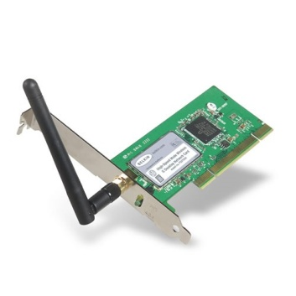
NetDevices and Channels
Some types of NetDevices are strongly bound to Channels of a matching type
More recently, NetDevices use a channel allowing multiple signal types to coexist
SpectrumChannel
CsmaChannel
CsmaNetDevice

Slide 29
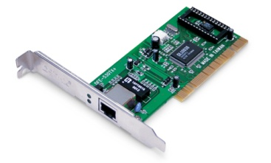
NetDevices and traces
ns-3 TraceSource objects are callbacks that may be hooked to obtain trace data from the simulator
Example: CsmaNetDevice
NetDevice::
ReceiveCallback
CsmaNetDevice::Send ()
MacTx
MacRx
MacDrop
queue
Sniffer
PromiscSniffer
MacTxBackoff
PhyTxBegin
PhyRxEnd
PhyRxDrop
PhyTxDrop
PhyTxEnd
CsmaNetDevice::
TransmitStart()
CsmaNetDevice::
Receive()
CsmaChannel

Slide 30
ns-3 program structure
Handle program inputs
Configure topology
Run simulation
Process outputs

Slide 31
Placeholder
Review examples/tutorial/first.cc

